Slide 1


Chapter 7
Repetition
Department of E-Commerce
Faculty of Science and Information Technology
Kolej Universiti Islam Antarabangsa Selangor (KUIS)
http://www.kuis.edu.my/fstm

Slide 2


There are many ways of doing repetition. Three of them:
  for
  while and do…while
  foreach

Slide 3

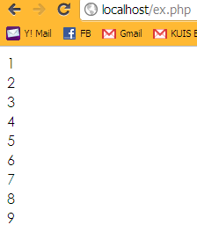
E.g.:
<?php
for ($i=1;$i<=9;$i++){
echo "$i<br>";
}
?>

Slide 4

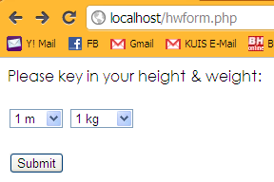
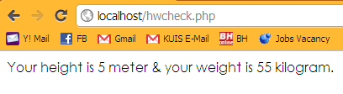
Example 1

